Slide 1
Signals and Systems (ELL205)
By Dr. Abhishek Dixit
Dept. of Electrical Engineering
IIT Delhi

Slide 2
Use cases
Fundamentals
  Digital signal processing (MP3, JPEG, MP4)
  Communication systems
  Machine learning
  Neural networks
  Optical signal processing
  Biomedical signal processing
  Physics
  Mathematics
  Computer science (data mining)
  Mechanical and civil engineering
No innovation and engineering happens without knowledge of Signals and Systems

Slide 3
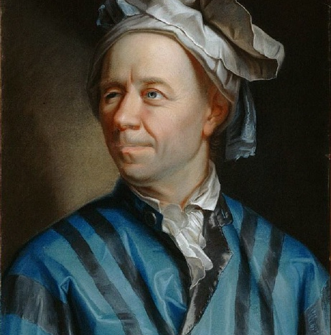
Work contribution
Euler

Slide 4
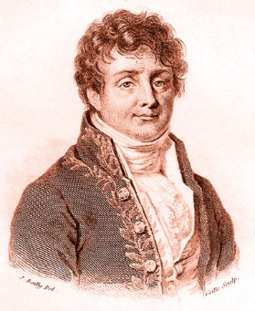
Work contribution
Euler
Fourier

Slide 5
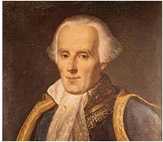
Work contribution
Euler
Fourier
Laplace

Slide 6
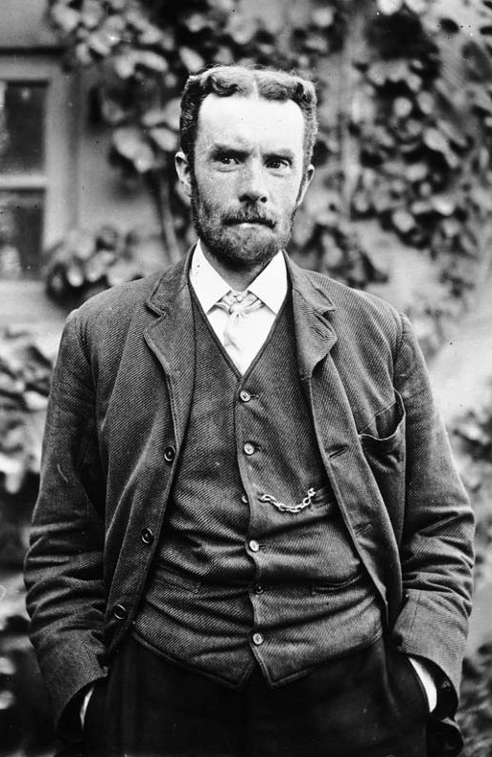
Work contribution
Euler
Fourier
Laplace
Oliver Heaviside

Slide 7
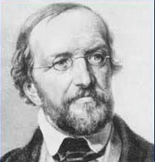
Work contribution
Euler
Fourier
Laplace
Oliver Heaviside
Dirichlet

Slide 8
Syllabus
Units | Topics | # of Lectures
I | Introduction to Signals and Systems | 5
II | Linear Time Invariant Systems | 8
III | Fourier Series Representation of S&S | 5
IV | Continuous-time Fourier Transform | 3
V | Discrete-time Fourier Transform | 4
VI | Discrete-time Fourier Series | 3
VII | Sampling | 3
VIII | The Laplace Transform | 3
IX | The Z Transform | 3
X | Applications of the course | 5
 | Total number of Lectures | 42

Slide 9
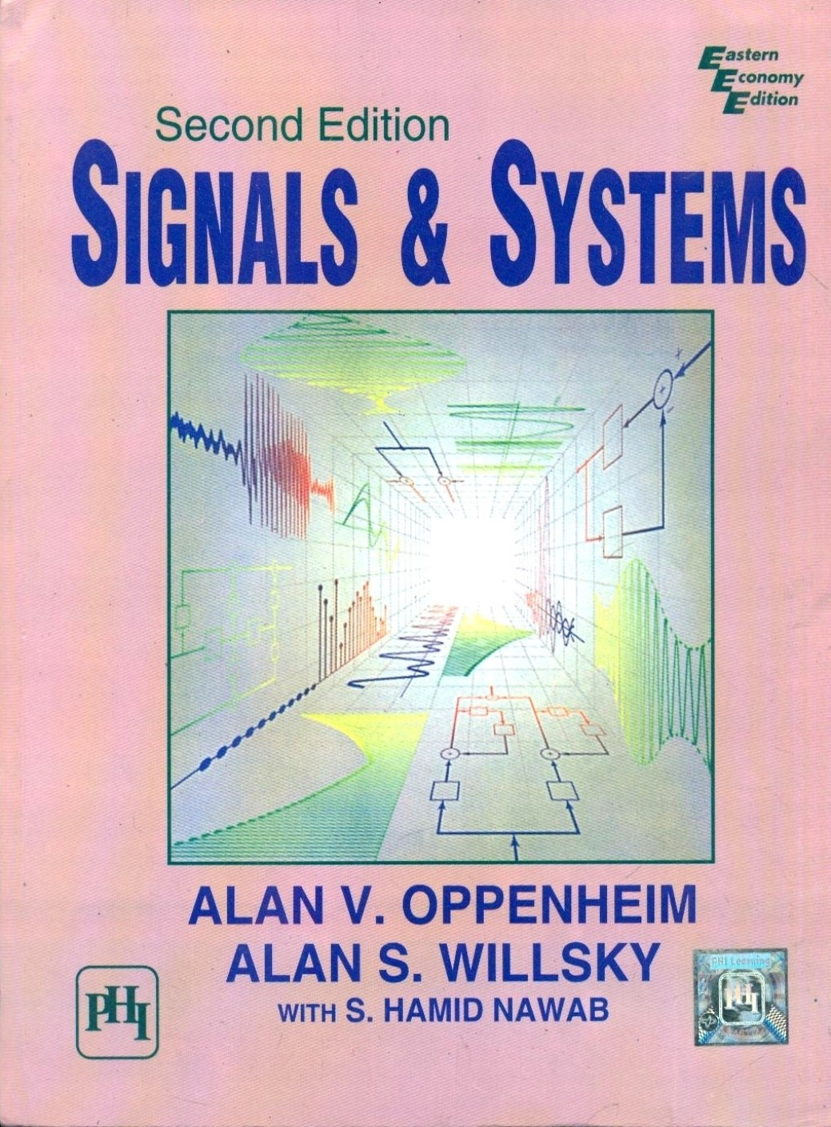
TEXT Book
Alan V. Oppenheim, A. S. Willsky, and S. Hamid Nawab, “Signals & Systems,” PHI, Second Edition.

Slide 10
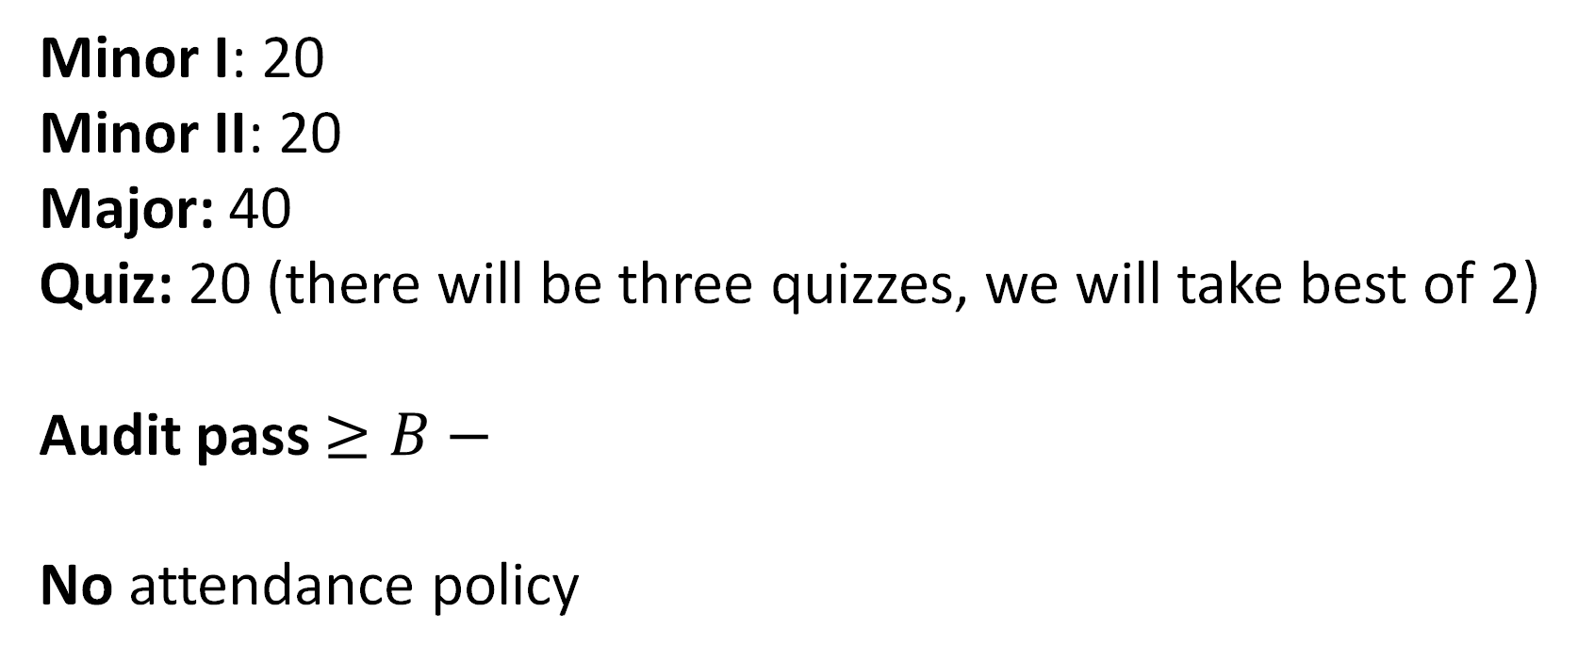
Evaluation pattern
Minor I: 20
Minor II: 20
Major: 40
Quiz: 20 (there will be three quizzes, we will take best of 2)
Audit pass $≥B−$
No attendance policy

Slide 11
Tutorials
On Tuesday, Thursday, Friday and Monday
  2-3 pm
Problem sheets will be uploaded in Moodle

Slide 12
Lectures and Tutorials
Lectures:
Days: On Tuesday, Wednesday and Friday
Timings: 9-10 am
Lecture rooms: LH-111 (Prof. Abhishek Dixit), LH-421 (Prof. Shankar Prakriya), LH-422 (Prof. Ranjan Mallik)
Tutorials:
Days: On Tuesday, Thursday, Friday and Monday
Timings: 2-3 pm
Lecture rooms: LH-421 (Prof. Abhishek Dixit) and LH-622 (Prof. Shankar Prakriya/Prof. Ranjan Mallik)
Problem sheets will be uploaded in Moodle

Slide 13
Other support
Prof. Abhishek Dixit
Email: abhishek.dixit@iitd.ac.in
Prof. Shankar Prakriya
Email: shankar@ee.iitd.ac.in
Prof. Ranjan Mallik
Email: rkmallik@ee.iitd.ernet.in
Piazza
Sign up on Piazza: https://piazza.com/iit_delhi/spring2023/ell205
Access code: ell205
You can ask for extra class by Piazza.

Slide 14
What do we learn in this course?
Language of describing signals and systems
Analyzing signals and systems
Observing signals and systems

Slide 15
What do we see?
Spectrum of the signal
Amplitude (kind of)
frequency

Slide 16
What do we see?
Different sounds correspond to different spectrum.

Slide 17
What do we see?
Different sounds correspond to different spectrum.
Instrument produces higher frequencies than what humans can.

Slide 18
What do we see?
Different sounds corresponds to different spectrum.
Instrument produces higher frequencies than what humans can.
A tone consists of only a few dominant frequencies (formants).

Slide 19




What do we see?
Different sounds corresponds to different spectrum.
Instrument produces higher frequencies than what humans can.
A tone consists of only a few dominant frequencies (formants).
Each instrument has a different timbre (ratio of spectral components).
$$a_{2}$$
Amplitude (kind of)
$$a_{3}$$
$$a_{1}$$
$$a_{4}$$
frequency

Slide 20
What do we see?
Different sounds corresponds to different spectrum.
Instrument produces higher frequencies than what humans can.
A tone consists of only a few dominant frequencies (formants).
Each instrument has a different timbre (ratio of spectral components).
Sharper sounds have a larger difference between the spectral components.
$$a_{2}$$
Amplitude (kind of)
$$a_{3}$$
$$a_{1}$$
$$a_{4}$$
frequency

Slide 21
What are signals and systems?

Slide 22
What are signals?
Signals are functions.
  Functions are maps between domain and range, with a restriction that one input can have at most one output.

Slide 23
What are signals?
Signals are functions.
  Functions are maps between domain and range, with a restriction that one input can have at most one output.
1
2
1
4
Domain
Range

Slide 24
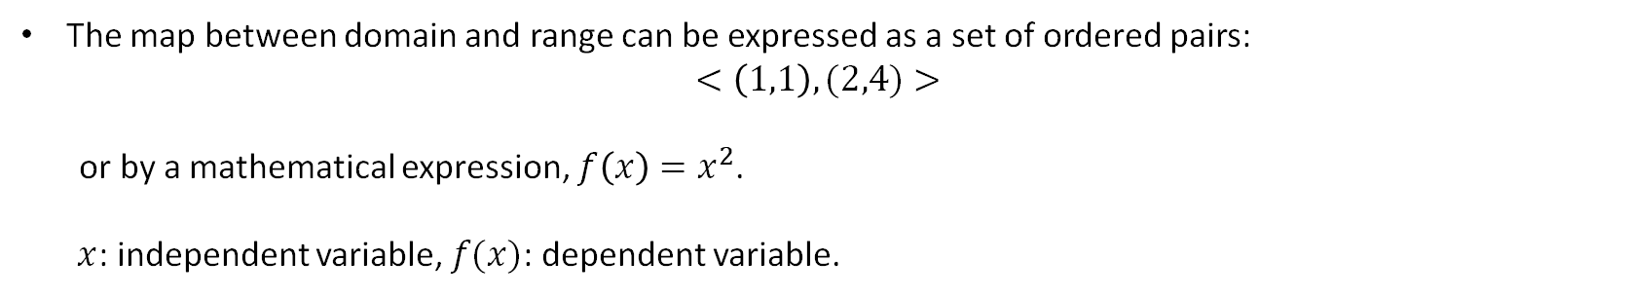
What are signals?
Signals are functions.
  Functions are maps between domain and range, with a restriction that one input can have at most one output.
1
2
1
4
Domain
Range
The map between domain and range can be expressed as a set of ordered pairs:
$$<\left(1,1\right),(2,4)>$$
or by a mathematical expression, $f\left(x\right)=x^{2}$.
$x$: independent variable, $f(x)$: dependent variable.

Slide 25
What are signals?
Signals are functions.
We focus on two independent variables: time and frequency. The function with independent variable as frequency is a special function known as spectrum.

Slide 26
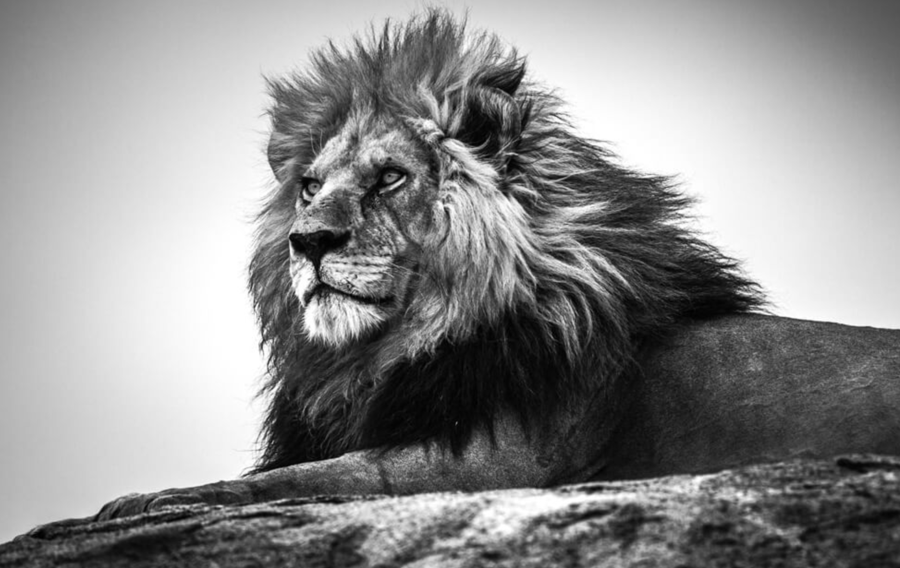
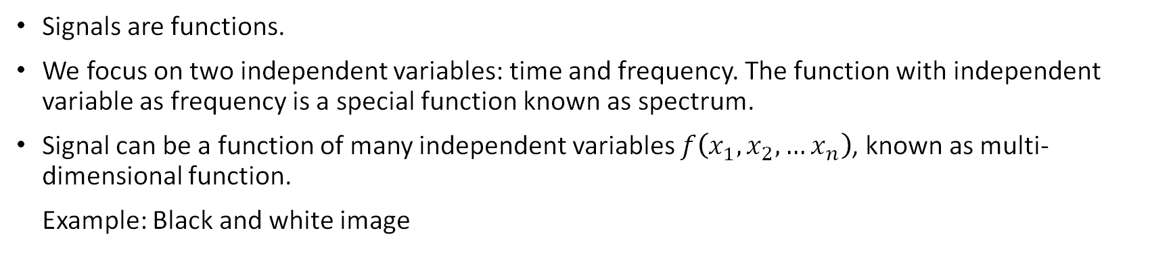



What are signals?
Signals are functions.
We focus on two independent variables: time and frequency. The function with independent variable as frequency is a special function known as spectrum.
Signal can be a function of many independent variables $f\left(x_{1},x_{2},…x_{n}\right)$, known as multi-dimensional function.
Example: Black and white image
$$y$$
$$f\left(x,y\right)=Brightness$$
Brightness is communicated by a real number
$$x$$

Slide 27
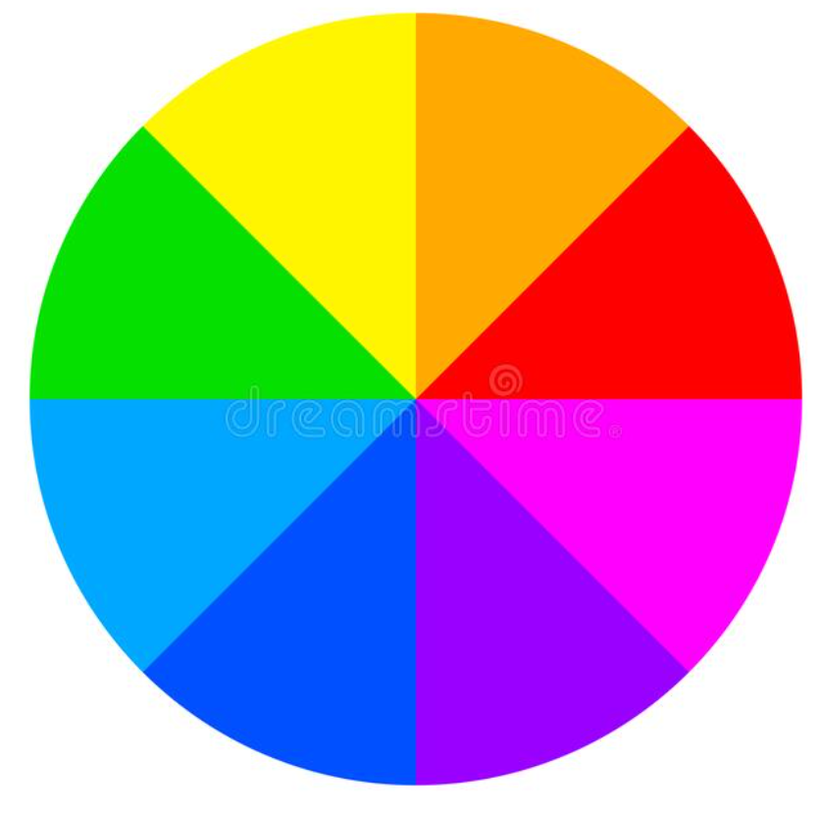



What are signals?
Signals can also have multi-dimensional range.
Example: Color images
$$y$$
$$f\left(x,y\right)=Color$$
Color is indicated by three real numbers:
First representing Red, the second representing Green, and the third representing Blue.
$$x$$

Slide 28
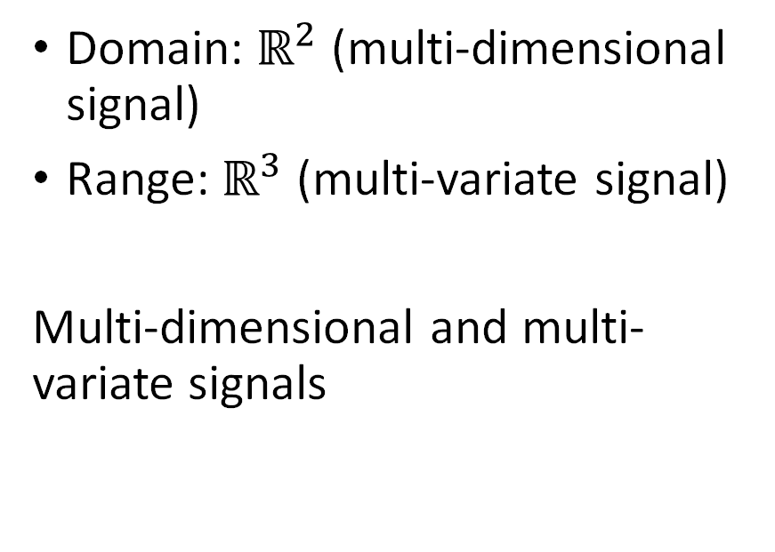
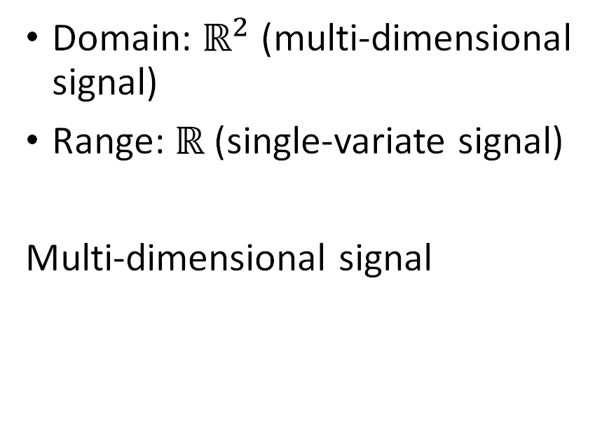
What are signals?
Black & White Image
Color Image
Domain: $ℝ^{2}$ (multi-dimensional signal)
Range: $ℝ$ (single-variate signal)
Multi-dimensional signal
Domain: $ℝ^{2}$ (multi-dimensional signal)
Range: $ℝ^{3}$ (multi-variate signal)
Multi-dimensional and multi-variate signals

Slide 29
What is a system?
System: represented by a rectangular block.

Slide 30
What is a system?
System: represented by a rectangular block.
Formal definition: A system is a process (or an abstraction of the process) which transforms a signal.

Slide 31
What is a system?
System: represented by a rectangular block.
Formal definition: A system is a process (or an abstraction of the process) which transforms a signal.
Simple definition: It takes one input function and gives out another function (or may be even the same signal in the case of the identity system).

Slide 32


What is a system?
System: represented by a rectangular block.
Formal definition: A system is a process (or an abstraction of the process) which transforms a signal.
Simple definition: It takes one input function and gives out another function (or may be even the same signal in the case of the identity system).
Example: Amplifier
$$f(x)$$
10$f(x)$

Slide 33
Outline
What are signals?
What are systems?
Different kinds of Signals
  Continuous-time vs. Discrete-time signals

Slide 34
Types of signals
Continuous-time signals vs. Discrete-time signals

Slide 35
Types of signals
Continuous-time signals vs. Discrete-time signals
Time is the independent variable, assumed just for convenience

Slide 36
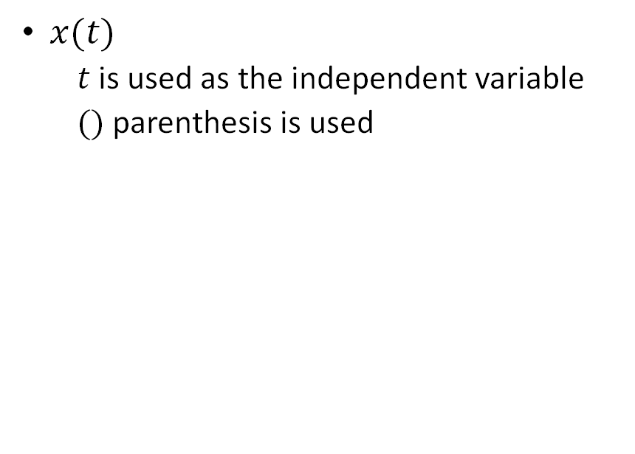
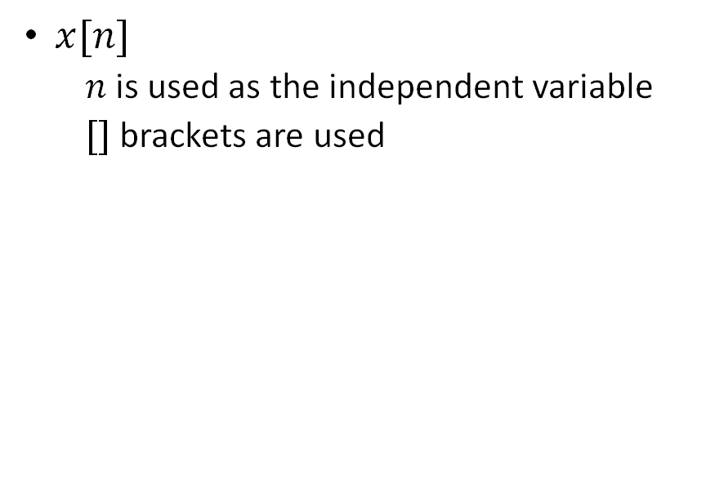
Types of signals
Continuous-time signals
Discrete-time signals
$x(t)$
  $t$ is used as the independent variable
  $()$ parenthesis is used
$x[n]$
  $n$ is used as the independent variable
  $[]$ brackets are used

